Slide 1

Question Classifier
Mateusz Dorobek

Slide 2

The Problem

Slide 3
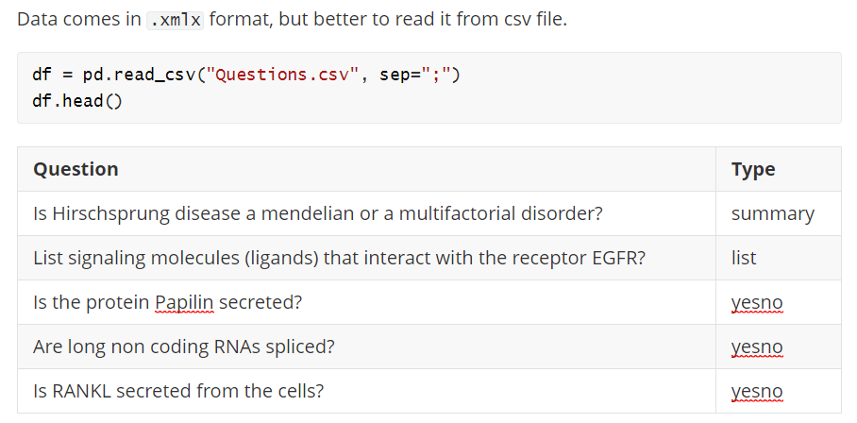
Data

Slide 4
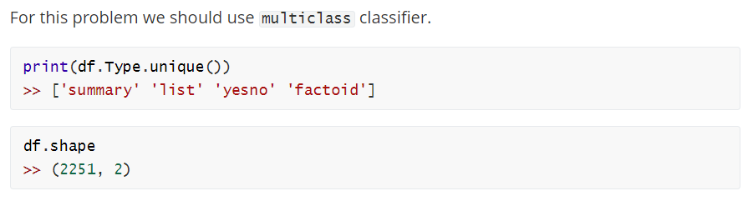
Data

Slide 5

Preprocessing

Slide 6
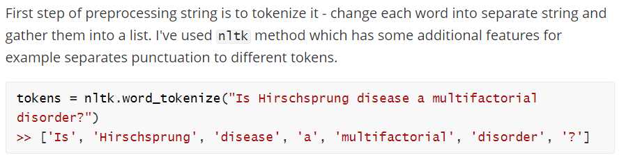
Tokenizing

Slide 7
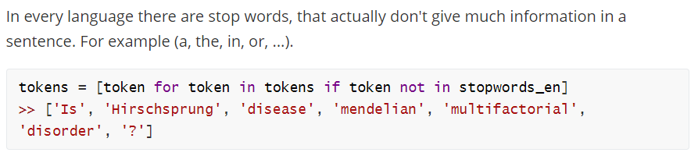
Stopwords

Slide 8
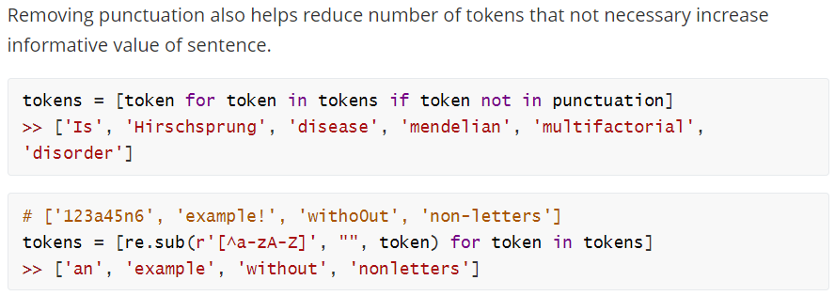
Punctuation

Slide 9
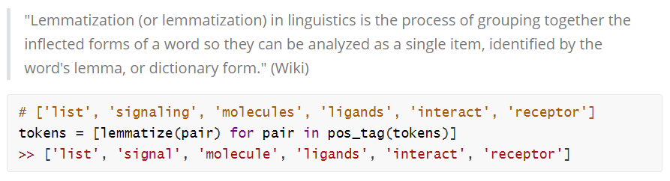
Lemmatization

Slide 10
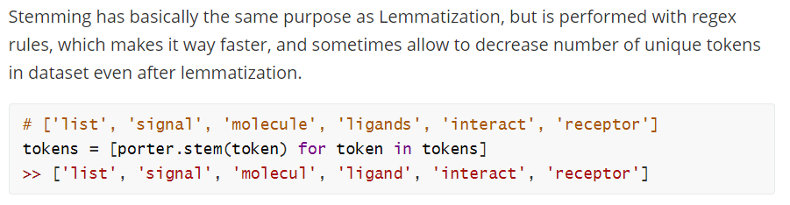
Stemming

Slide 11
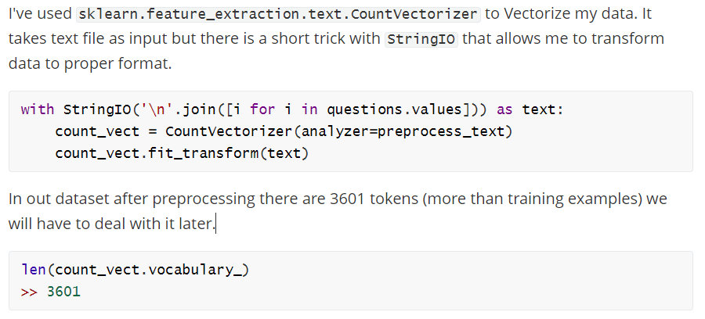
Vectorization

Slide 12
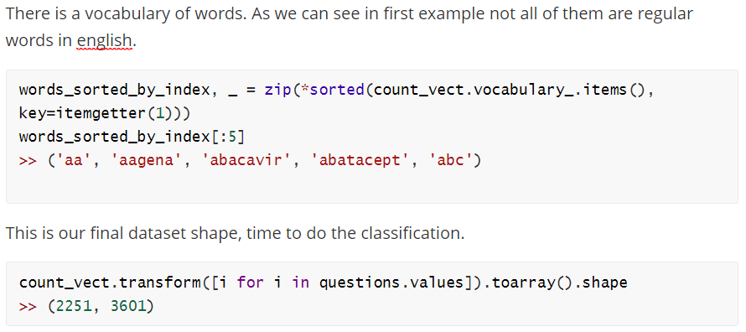
Final data shape

Slide 13
Classification

Slide 14
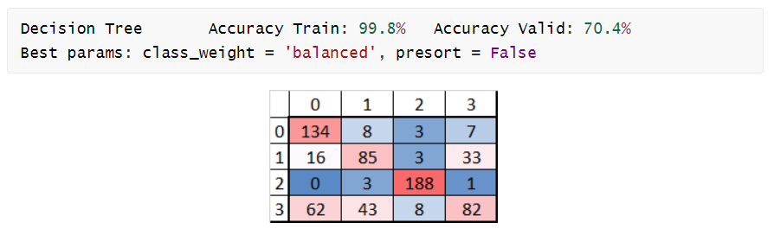
Decision Tree

Slide 15
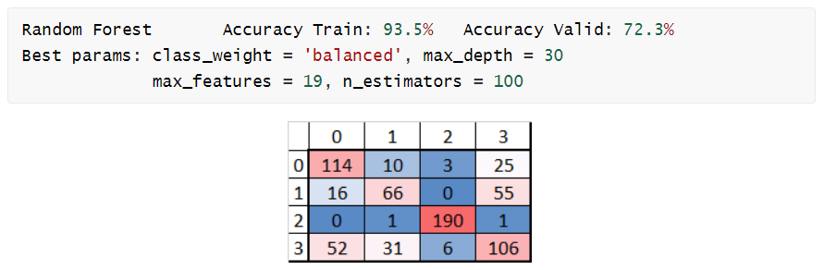
Random Forest

Slide 16
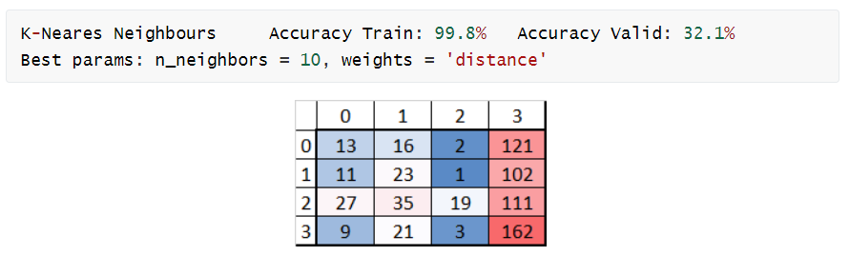
K-Neares Neighbours

Slide 17
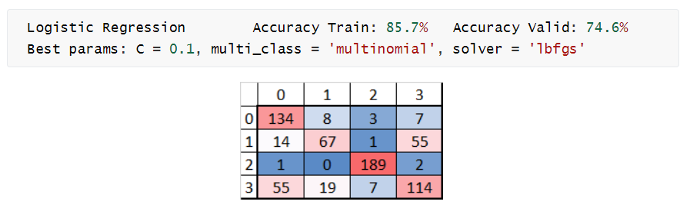
Logistic Regression

Slide 18
Notes
I've tested that PCA doesn't improve performance of any of classifiers.
Using StandarScaler() wasn't a good due to binary character of data.
My validation metric was accuracy due to even distibution in class.

Slide 19
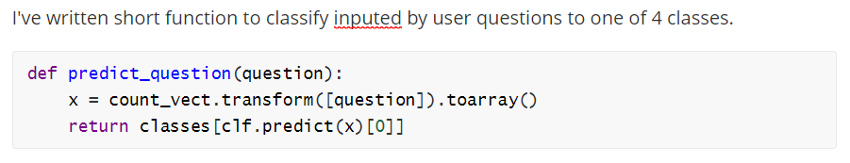
Results

Slide 20
Results
List two of your favourie films. list
Where are you? factoid
How old are you? summary

Slide 21
Results
Do you like to study? yesno
How do you feel rright now? summary
What is your name? summary

Slide 22
Thank you

